Slide 1
PARBA flow training CV Team
Mar 20th, 2013

Slide 2
Agenda
What is PARBA flow
How to run PARBA flow
Toggle coverage for PARBA flow

Slide 3
What is PARBA flow
The power aware repeater simulation flow uses the repeater which contains the tile instance and power domain information to run power simulation with repeater power on and off.
The PARBA flow is divided into two categories enhancement compared to normal repeater flow:
1. back-annotated repeaters have more hierarchy and power domain information
2. generated top upf file contains more repeater information

Slide 4
Back-annotated repeaters
The generated repeater files are different. Besides the normal repeater information, the repeater verilog files in power aware simulation will have more information such as buf instance, tile instance information and power domain information. These information will help to realize repeater power up and down during simulation

Slide 5
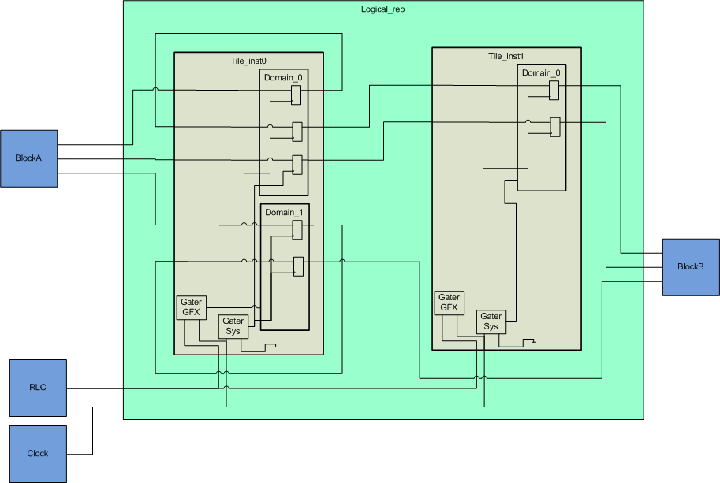
Back-annotated repeaters

Slide 6
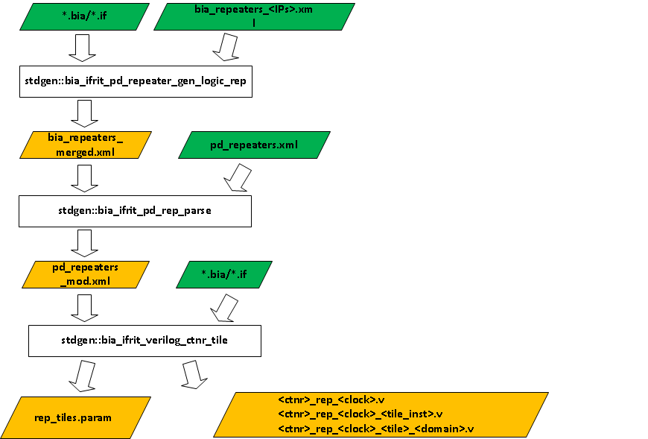
Back-annotated repeaters

Slide 7
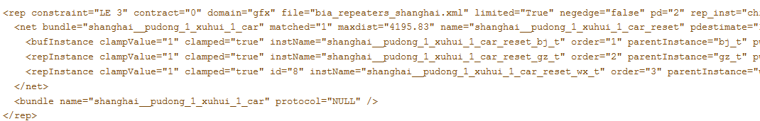
Back-annotated repeaters
Input files:
Same input files as normal flow:
*.bia, *.if, bia_repeaters_setup.xml
New input files: pd_repeaters.xml

Slide 8
Back-annotated repeaters
Output files:
Back-annotated repeater verilog and ale files
*.v, *.ale
Power parameters for repeaters

Slide 9
Repeaters UPF generation
PG mode Repeater upf flow
1 you need add these words
self.sim_build_args << " -build_opts ' -param upf_param_flow.repeater_upf=1'“
in your config infile configs.dj
2 then flow will pass –RepeaterUpf to genChipUpf.csh
It then will use $OUT_DESIGN_pub/src/meta/dfp/params/rep_tiles.params as its repeater parameter

Slide 10
Repeaters UPF generation
PG mode Repeater upf flow
3 then call command to generate repeater upf in SYS.upf.2.0
env env OUT_CMN_pub=/proj/cv_srdc1/niwang/kalindi/out/amd64rh3.0.VCS/common/pub OUT_DESIGN_pub=/proj/cv_srdc1/niwang/kalindi/out/amd64rh3.0.VCS/kabini/common/pub /proj/cv_srdc1/niwang/kalindi/out/amd64rh3.0.VCS/common/pub/src/meta/tools/dfp/template/chip.upf.tmpl -o SYS.upf.2.0 -d CHIP_UPF_MODE=pg -d TILE_UPF_EXISTS=0 -d PG_TOP=SYS -I /proj/cv_srdc1/niwang/kalindi/_ip/soc_dv_xnb/_env/local/../../src/verif/tb/bin:/proj/cv_srdc1/niwang/kalindi/_ip/thermal/_env/thermal.local/../../tb:/proj/cv_srdc1/niwang/kalindi/setup:/proj/cv_srdc1/niwang/kalindi/auto/kalindi_amd64rh3.0_dbg/lib/perl:/proj/cv_srdc1/niwang/kalindi/auto/kalindi_amd64rh3.0_dbg/bin:/proj/cv_srdc1/niwang/kalindi/out/amd64rh3.0.VCS/common/pub/lib/perl:/proj/cv_srdc1/niwang/kalindi/out/amd64rh3.0.VCS/common/pub/bin:/proj/verif_release_ro/CDC_Verif/58/lib/perl:/proj/verif_release_ro/leda_rules/83/lib:/proj/verif_release_ro/rgb_build/153:/proj/verif_release_ro/rgb/57:/proj/verif_release_ro/rgb/57/aleLexer/blib/lib:/proj/verif_release_ro/fm_verif_plugins/286/lib/perl:/proj/verif_release_ro/flow_managers/90/lib/perl:/proj/verif_release_ro/dispatch/226/lib/perl:/proj/verif_release_ro/dvtgen/124/lib/perl:/proj/verif_release_ro/compression_utils/15/lib/perl:/proj/verif_release_ro/drop2cad/80/lib/perl:/proj/verif_release_ro/ustat_send/8/lib/perl:/proj/verif_release_ro/utils/55/lib/perl:/proj/verif_release_ro/xml_utils/42/lib/perl:/proj/verif_release_ro/siteconfig/current/lib/perl:/proj/verif_release_ro/project_config/22/lib/perl:/proj/verif_release_ro/p4w/164:/proj/verif_release_ro/cbwa/205/lib/perl:/proj/verif_release_ro/p4_mkwa/current:/proj/verif_release_ro/error_reporting/25/lib/perl:/proj/verif_release_ro/cbwa_bootcore/current/lib/perl -I /proj/cv_srdc1/niwang/kalindi/out/amd64rh3.0.VCS/common/pub/src/meta/tools/dfp/scripts -I publish -d LSF=1 -d SRAM_DIS=1 -p /proj/cv_srdc1/niwang/kalindi/out/amd64rh3.0.VCS/kabini/common/pub/src/meta/dfp/params/rep_tiles.params -d SIMULATION=1

Slide 11
Repeaters UPF generation
PG mode Repeater upf flow
4 the repeater upf in SYS.upf.2.0 in kalindi
env env OUT_CMN_pub=/proj/cv_srdc1/niwang/kalindi/out/amd64rh3.0.VCS/common/pub OUT_DESIif ($SIMULATION) {
# define repeater GLB domain
create_supply_set REP_SS_GLB
create_supply_set REP_SS_GLB -function {power VDDCR_NB} -function {ground VSSnet} –update
…
set_isolation ISO_LO_usblk_lds001 \
-domain REP_PD_P2_usblk_lds001 \
-source REP_SS_P2_usblk_lds001 \
-diff_supply_only TRUE \
-isolation_power_net VDDCR_NB \
-isolation_ground_net VSSnet \
-clamp_value 0
set_isolation_control ISO_LO_usblk_lds001 \
-domain REP_PD_P2_usblk_lds001 \
-isolation_signal usblk_lds001/bpm/TTOP_P2_iso_clampn \
-location self \
-isolation_sense low
…
}

Slide 12
Repeaters UPF generation
PGVI mode Repeater upf flow
1 you need add these words
self.sim_build_args << " -build_opts ' -param upf_param_flow.repeater_upf=1'“
in your config infile configs.dj
self.sim_build_args << " -build_opts ' -param upf_param_flow.config=#{ENV['STEM']}/src/test/suites/vi/params/config_parba.params'“
Which is user seting in config_parba.params
2 there is an example about config_parba.params
USE_TOP_UPF_TMPL = 1
TOP_UPF_PST_TMPL = <:=$STEM:>/src/meta/tools/dfp/template/upf_pst_pgvi.tmpl
TOP_UPF_TMPL = <:=$STEM:>/src/meta/tools/dfp/template/top_pgvi.upf.tmpl
TOP_UPF_PARAM = <:=$STEM:>/src/meta/tools/dfp/template/top.params.tmpl
TOP_REP_TMPL = <:=$STEM:>/src/meta/tools/dfp/template/repeater_parba.tmpl
REPEATER_ENBALE = 1

Slide 13
Repeaters UPF generation
PGVI mode Repeater upf flow
3 then flow will pass –RepeaterUpf to genChipUpf.csh
use the same parameter $OUT_DESIGN_pub/src/meta/dfp/params/rep_tiles.params as its repeater parameter
4 call chip.upf.tmpl, call top.params.tmpl, call top_pgvi.upf.tmpl, call repeater_parba.tmpl to generate repeater upf in SYS.upf.2.0

Slide 14
Repeaters UPF generation
PGVI mode Repeater upf flow
5 the repeater upf contents in SYS.upf.2.0 from Cipher
# repeater UPF
if ($SIMULATION) {
# define repeater GLB domain
create_supply_set REP_SS_GLB
create_supply_set REP_SS_GLB -function {power VDDGFX} -function {ground VSS} -update
create_supply_set REP_SS_VDDNB
create_supply_set REP_SS_VDDNB -function {power VDDNB} -function {ground VSS} –update
…
set_domain_supply_net REP_PD_P2_usblk_sq104 -primary_power_net REP_SS_P2_usblk_sq104.power -primary_ground_net REP_SS_P2_usblk_sq104.ground
puts "iso low rule from REP_SS_P2_usblk_sq104 "
set_isolation ISO_LO_usblk_sq104 \
-domain REP_PD_P2_usblk_sq104 \
-source REP_SS_P2_usblk_sq104 \
-diff_supply_only TRUE \
-isolation_power_net VDDGFX \
-isolation_ground_net VSS \
-clamp_value 0
set_isolation_control ISO_LO_usblk_sq104 \
-domain REP_PD_P2_usblk_sq104 \
-isolation_signal usblk_sq104/bpm/TTOP_P2_iso_clampn \
-location self \
-isolation_sense low
…
}

Slide 15
How to run PARBA flow
All the Steps to enable PARBA flow is listed in the following webpage
http://twiki.amd.com/twiki/bin/view/DesignCAD/How_to_run_bia_pd_repeater_flow_in_VI

Slide 16
Toggle coverage for PARBA flow
We have a script to generate the coverage checking points according to the current repeater files.
Flow setup
1 make sure below files in your stdgen which was used to generate the coverage sv file:
bia_ifrit_pd_repeater/album.dj
bia_ifrit_pd_repeater/scripts/ReadTopModule.pm
bia_ifrit_pd_repeater/toggle_cov/Makefilebia_ifrit_pd_repeater/toggle_cov/Makefile
bia_ifrit_pd_repeater/toggle_cov/album.dj
bia_ifrit_pd_repeater/toggle_cov/toggle_cover.pl

Slide 17
Toggle coverage for PARBA flow
2 we need to place the coverage file in a separate ale file which can be added into your design , there is an example in kalindi:
Add below code $OUT_DESIGN_pub/src/meta/connectivity/rep_feed_pg_func_cov.sv in
//gnbA/kalindi/main/src/verif/coverage/pg/cover_all_pg/assembly/cover_all_pg.ale
And below code in
need stdgen::bia_ifrit_verilog_ctnr_tile
//gnbA/kalindi/main/src/verif/coverage/pg/cover_all_pg/assembly/album.dj

Slide 18
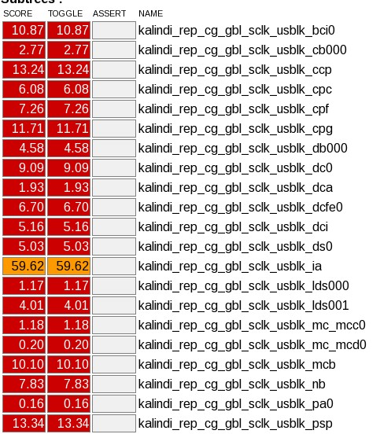
Toggle coverage for PARBA flow
3 then setenv TOGGLE_PARBA 1 and run your test
dj -e 'run_test “your test "' -l parba.log -m 8 -DCM -DCMOPT=assert+tgl -DCM_NOCONST -DCM_HIER=$STEM/src/sim/setup/cm_hier.txt -J lsf
You need to go to $STEM/out/…/pub/sim/exec and there run: urg –full64 –dir sim_vcs.vdb

Slide 19
PARBA docs
http://twiki.amd.com/twiki/bin/view/DesignCAD/Power_Aware_Repeaters_Flow

Slide 20
Q & A

